Slide 1
Sequence, Selection, and Iteration

Slide 2
Control structures
Any program uses:
sequence
selection
iteration (repetition)

Slide 3
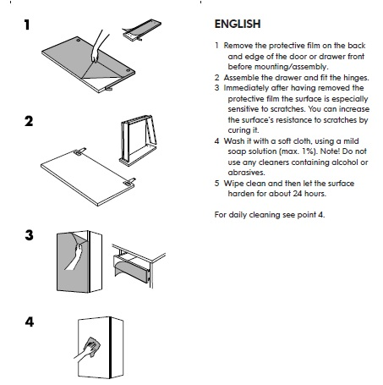
Everyday example of sequential instructions
do you think these instructions are at the same level of detail?
In a sequence, statements are performed in the order they are written
Sounds easy but the sequence is not always obvious
why do you think there are a different number of steps? (it’s the same process)

Slide 4
Everyday example of sequential instructions
Remove the protective film on the back and edge of the door or drawer front before mounting/assembly.
does this need more detail?
what is involved in 'drawer assembly'?
what is involved in fitting the hinges?
Assemble the drawer and fit the hinges.
Immediately after having removed the protective film the surface is especially sensitive to scratches. You can increase the surface's resistance to scratches by curing it.
is this an instruction? if not, what is it?
do we keep it?
Wash it with a soft cloth, using a mild soap solution (max. 1%). Note! Do not use any cleaners containing alcohol or abrasives.
Wipe clean and then let the surface harden for about 24 hours.

Slide 5
Everyday example of sequential instructions
Remove the protective film on the back and edge of the door or drawer front before mounting/assembly.
Remove the protective film on the back and edge of the door or drawer front before mounting/assembly.
Assemble the drawer and fit the hinges.
Assemble the drawer and fit the hinges.
Immediately after having removed the protective film the surface is especially sensitive to scratches. You can increase the surface's resistance to scratches by curing it.
it isn't telling us to do anything
but is it telling us anything useful/necessary?
Wash it with a soft cloth, using a mild soap solution (max. 1%). Note! Do not use any cleaners containing alcohol or abrasives.
Wash it with a soft cloth, using a mild soap solution (max. 1%). Note! Do not use any cleaners containing alcohol or abrasives.
Wipe clean and then let the surface harden for about 24 hours.
Wipe clean and then let the surface harden for about 24 hours.

Slide 6
Everyday example of sequential instructions
option 1
option 2
Remove the protective film on the back and edge of the door or drawer front before mounting/assembly.
Remove the protective film on the back and edge of the door or drawer front before mounting/assembly.
Assemble the drawer and fit the hinges.
Wash it with a soft cloth, using a mild soap solution (max. 1%). Note! Do not use any cleaners containing alcohol or abrasives.
Wash it with a soft cloth, using a mild soap solution (max. 1%). Note! Do not use any cleaners containing alcohol or abrasives.
Wipe clean and then let the surface harden for about 24 hours.
option 3?
Wipe clean and then let the surface harden for about 24 hours.
Assemble the drawer and fit the hinges.
Immediately after having removed the protective film the surface is especially sensitive to scratches. You can increase the surface's resistance to scratches by curing it.
does the comment we removed say anything about the order we must/should/could order our sequence of instructions?

Slide 7
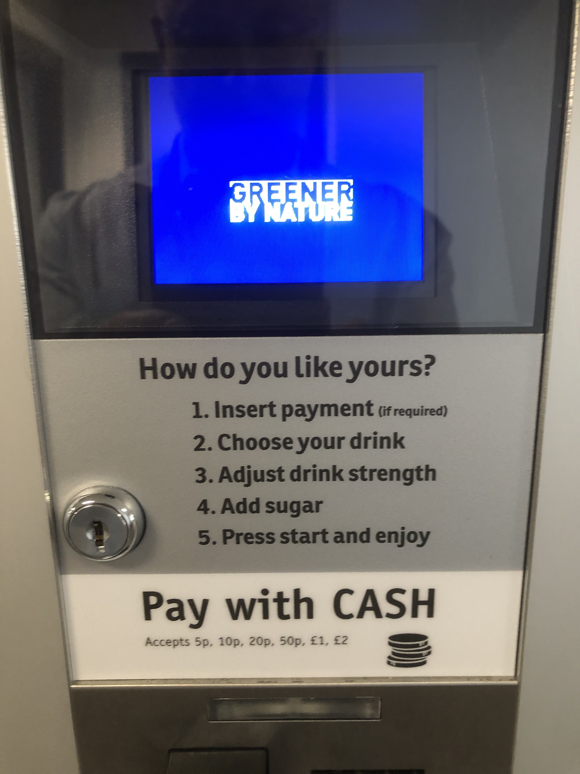
Everyday example of sequential instructions?
let's look at another example – a vending machine
Insert payment (if required)
Choose your drink
Adjust drink strength
Add sugar
Press start and enjoy
is this another example of sequential instructions?
there is definitely a sequence…
there is a question mark though…

Slide 8
Everyday example of selection instructions?
…there are choices involved
Insert payment (if required)
this one depends on the vending machine’s state?
Required
Not required
Choose your drink
these depend on user choice
BUT
do they depend on anything else?
Coffee?
Tea?
Hot Chocolate?
Adjust drink strength
Weak?
Normal?
Strong?
Add sugar
Add?
Don't add?
Press start and enjoy
I don't think 'enjoyment' is a choice here

Slide 9
Everyday example of selection instructions?
what are we still missing?
Insert payment (if required)
Required
Not required
Choose your drink
Coffee?
Tea?
Hot Chocolate?
Adjust drink strength
Weak?
Normal?
Strong?
Add sugar
Add?
Don't add?
Press start and enjoy
how many times will the vending machine be used?

Slide 10
Everyday example of iteration instructions?
is this the start of the loop?
start here
Insert payment (if required)
Required
Not required
completing the loop
Choose your drink
Press start and enjoy
Coffee?
Tea?
Hot Chocolate?
Add sugar
Adjust drink strength
Add?
Don't add?
Weak?
Normal?
Strong?

Slide 11
Everyday example of iteration instructions?
what is the condition for entry?
start here?
Insert payment (if required)
Required
Not required
what would the start condition be?
completing the loop?
or is this completing the loop?
or here?
Choose your drink
Press start and enjoy
Coffee?
Tea?
Hot Chocolate?
even if it is (in practice), does it change the loop start condition?
Add sugar
Adjust drink strength
Add?
Don't add?
Weak?
Normal?
Strong?

Slide 12
You should now know…
What sequencing is
What selection is
What iteration is

Slide 13
Any questions?

